Slide 1
18-755 – Paper Review Presentation
November 9, 2022
Vikas Kashyap, Tony Huang (Group 8)

Slide 2
1. Overview – Problem Statement and Objective
TABLE OF
CONTET
2. Highlights – Key Findings and Impacts
3. Critique – Strengths and Weaknesses
4. Q & A

Slide 3
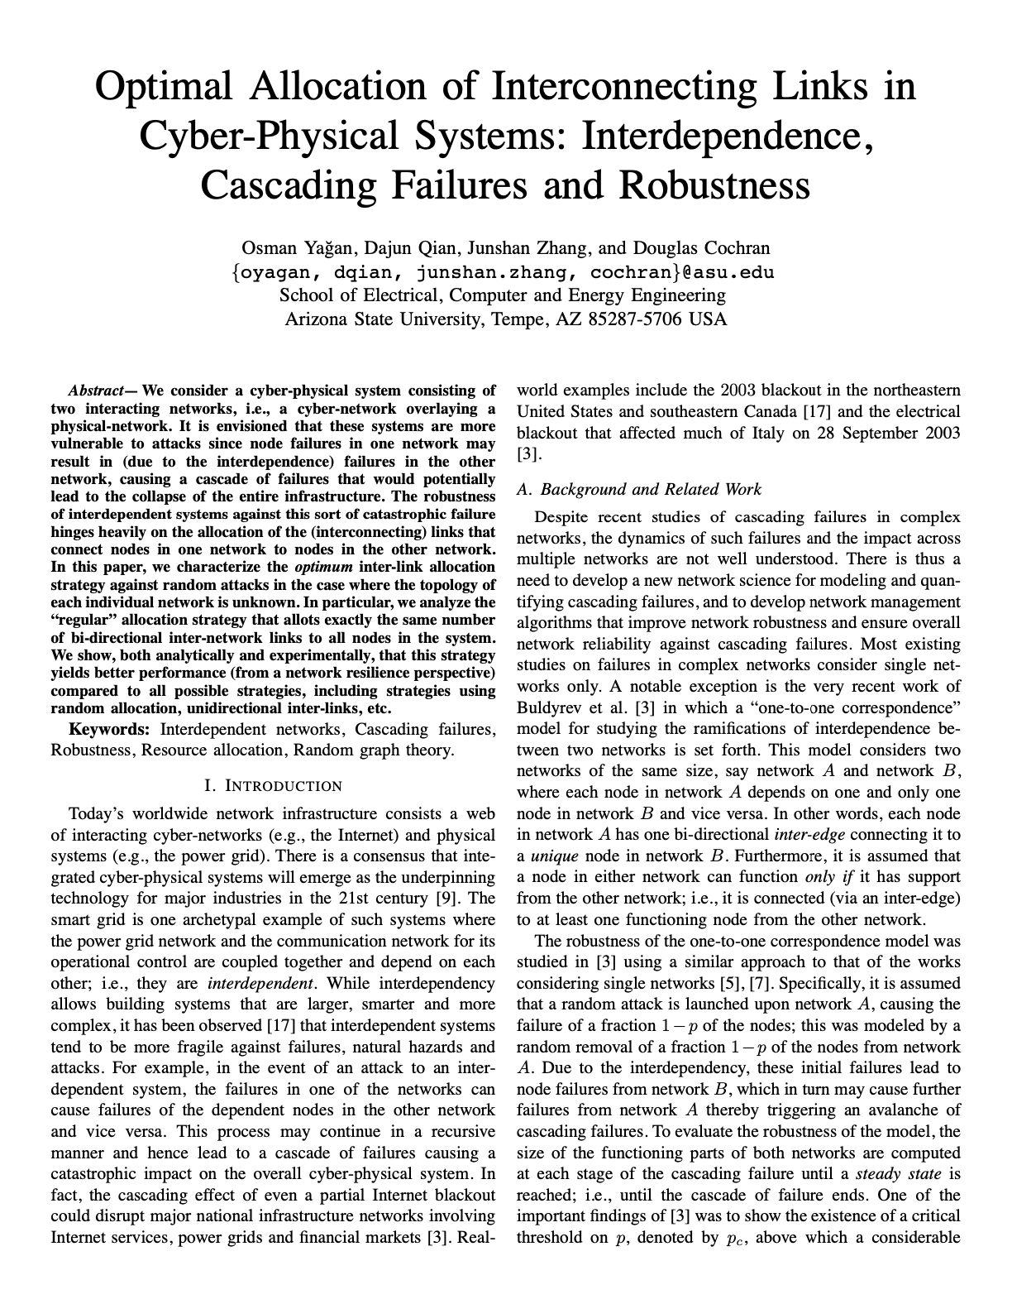
Overview of the Paper
Overview
Paper Title
Optimal Allocation of Interconnecting Links in Cyber-Physical Systems: Interdependence, Cascading Failures and Robustness
Author
Osman Yagan, Dajun Qian, Junshan Zhang, and Douglas Cochran
Publication &
Date
IEEE, (Volume: 23, Issue: 9, September 2012)
Key Topics
Interdependent networks, cascading failures, network robustness, resource allocation and random graph theory

Slide 4
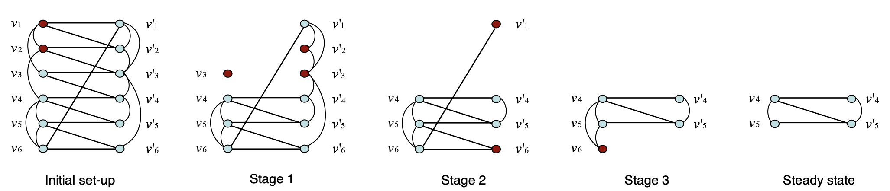
Background and Objective of the Paper
Overview
Background
Real-world networks are complicated and connected. Failures in one network have cascading effect on other networks.
Objective
The objective is to investigate how edges should connect for maximum robustness and the threshold at which networks collapse
Setting
Two interdependent networks are considered, and the effects of regular and random allocation are simulated.

Slide 5
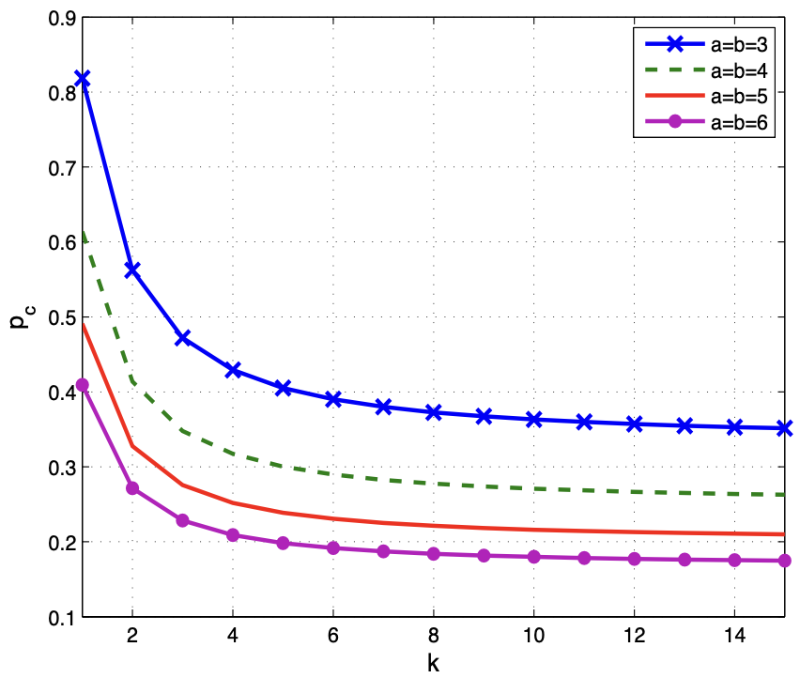
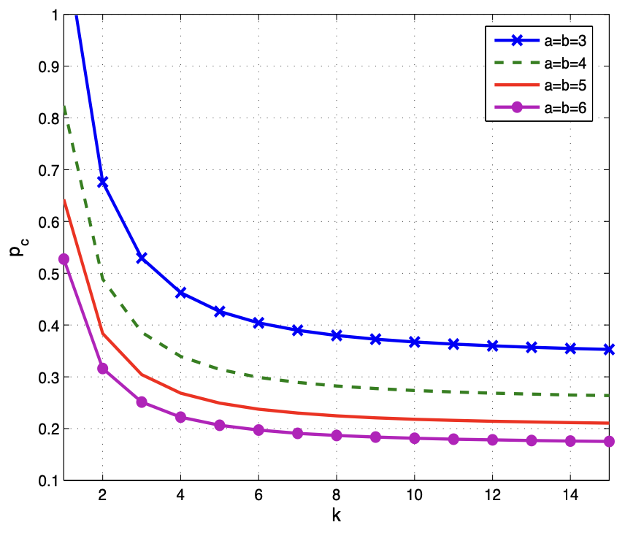
Key Results and Conclusion
Key points and impact
Critical Value for Regular Allocation
Critical Value for Random Allocation
Key Findings and Impact
As k increases, the robustness of the system increases for both regular and random allocation
For random allocation, in some cases, the system collapses without attacking any node
The results conclude that regular allocation (i.e., all nodes have same number of bi-directional inter-edges) is more robust than random allocation
Note: $P_{c}$ denotes the threshold below which the network collapses, k the number of nodes in each network, a and b the mean intra-degrees

Slide 6
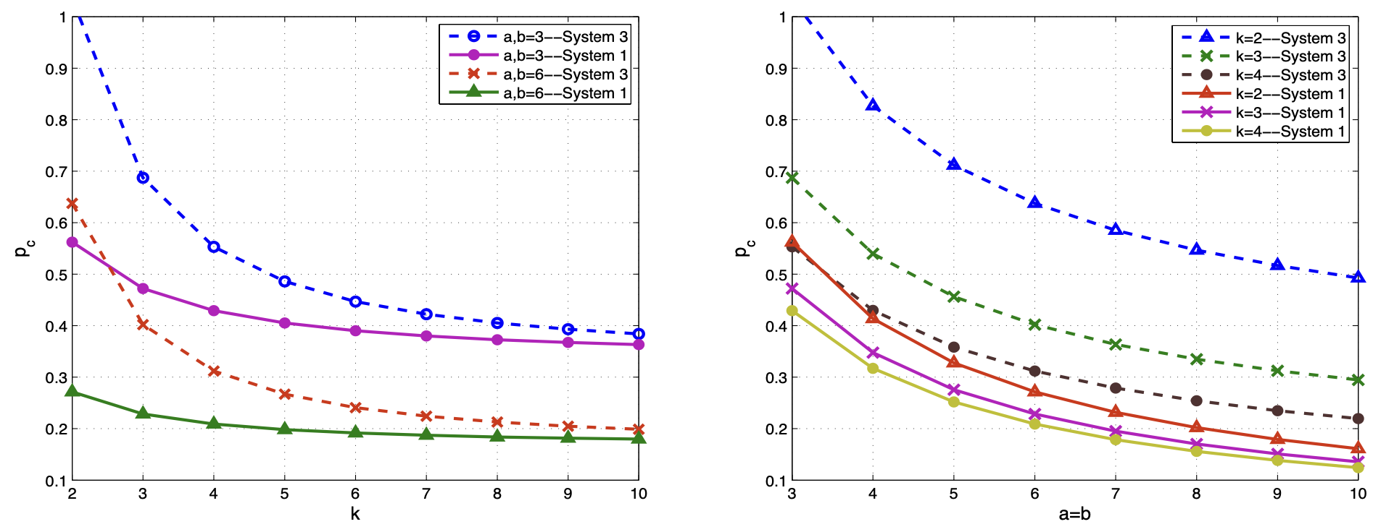
Key Results and Conclusion
Key points and impact
Critical Value for Same k Value
Critical Value for Same a, b Value
Key Findings and Impact
Holding the value of k constant, bi-directional inter-edge yields higher robustness
Holding the values of a and b constant, bi-directional inter-edge yields higher robustness
The result concludes that regular allocation with bi-directional inter-edge is more robust than regular allocation with unidirectional inter-edge
Note: System 1 denotes the bi-directional inter-edge regular allocation strategy, and system 3 denotes unidirectional inter-edge regular allocation strategy

Slide 7
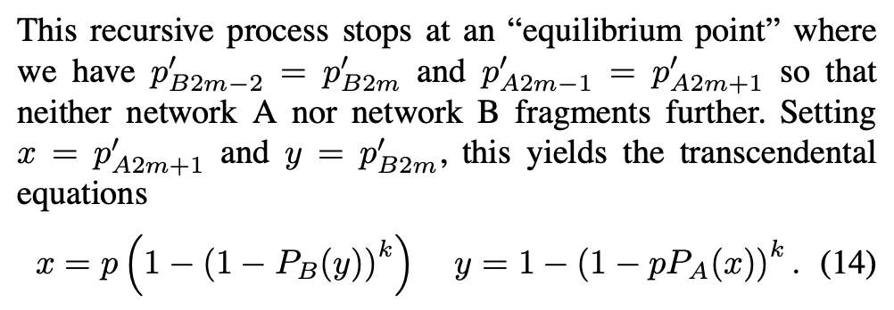
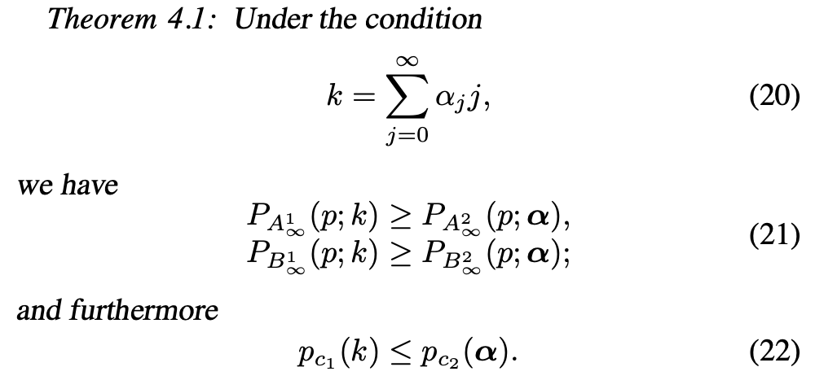
Strengths of the Paper
Strengths and weaknesses
STRENGTH 1
Explicit Derivation of the Critical Threshold
STRENGTH 2
Mathematical Proof of Relative Robustness of Networks
Previous papers on similar topics use simulation to show the existence of critical threshold
This paper leverages the technique of generating function to determine the “equilibrium point,” which can be solved explicitly given the intra-structures of the networks
The relative robustness between regular and random allocation, and between bi-directional and unidirectional networks are mathematically proven
The results are generic and is applicable to other network scenario

Slide 8
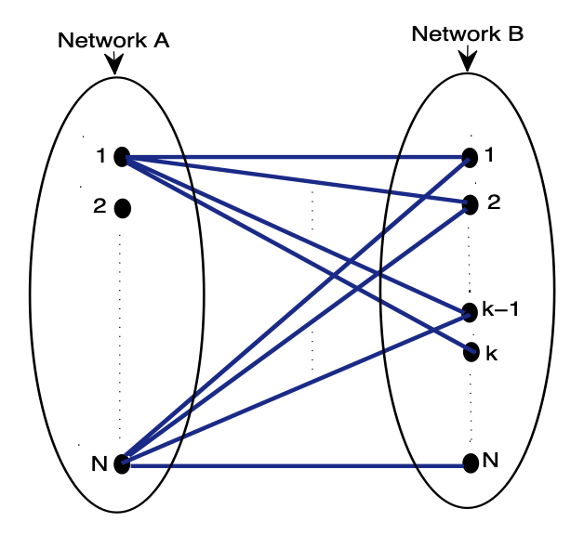
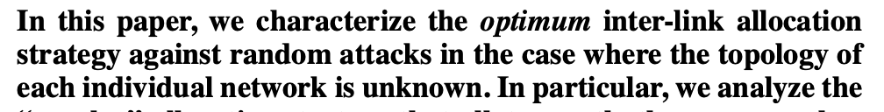
Weaknesses and Future Directions
Strengths and weaknesses
WEAKNESS 1
Limited Sets of Parameters were Tested
WEAKNESS 2
Topology Information is not Assumed
WEAKNESS 3
Edges Contain No Information (Unweighted)
The value of k ranges between 0 to 15, while the values of a/b ranges between 3 to 10
The networks have relatively small-size and may not be representative of real-world networks
This paper assumes the absence of topological information about the networks
In the presence of information, optimal strategy may be different
This paper assumes that the intra- and inter-edges carry no weights
In real world, edges between systems may be correlated and thus lead to different results
Notes:
The paper assumes that no topological information about the networks are known

Slide 9
References
APPENDIX
1. Optimal Allocation of Interconnecting Links in Cyber-Physical Systems: Interdependence, Cascading Failures and Robustness
https://ieeexplore.ieee.org/document/6148227

